Slide 1
Embracing Test-Driven Development (TDD)
Enhancing Software Quality and Maintainability

Slide 2
What is Test-Driven Development?
TDD is a software development approach where tests are written before the code.
It involves a cycle of writing a test, making it pass, and then refactoring the code.
TDD encourages simple designs and inspires confidence.

Slide 3
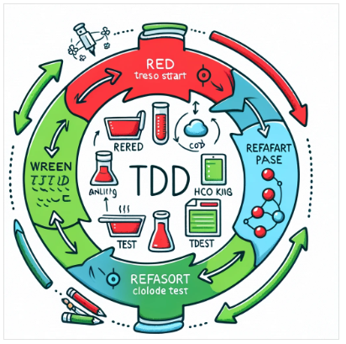
The TDD Cycle
Red: Write a failing test that defines a desired improvement or new function.
Green: Write the minimum amount of code necessary to pass the test.
Refactor: Clean up the new code, ensuring it fits well with the existing design.

Slide 4
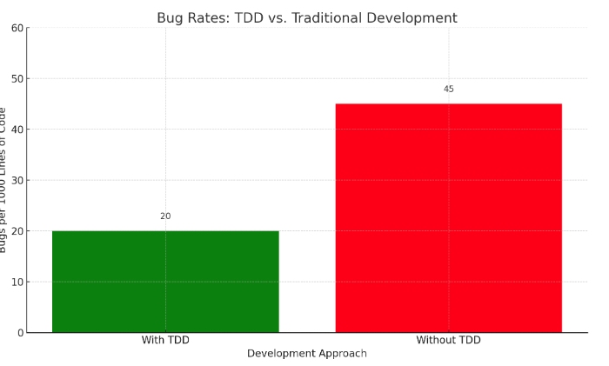
Benefits of TDD
Why adopt TDD?
Improves code quality and reduces bugs.
Facilitates design and architecture thinking before coding.
Makes refactoring and maintenance safer and easier.

Slide 5
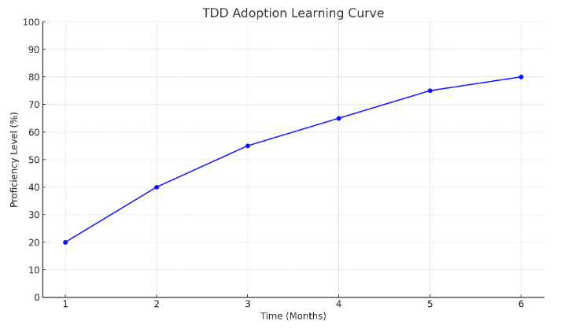
Challenges of TDD
Initial learning curve and time investment.
Writing effective and meaningful tests.
Maintaining discipline to stick to the TDD cycle.

Slide 6
Best Practices in TDD
Keep tests small and focused.
Test public behaviors, not internal implementations.
Refactor both new code and tests to keep them clean and readable.

Slide 7
Real-World TDD Example
Case Study: Refactoring a Legacy System
Starting with writing tests for existing functionality.
Gradually introducing new features with TDD.
Continuous integration and testing ensure system stability.

Slide 8
Future of TDD
TDD's role in emerging software development paradigms.
Integration with DevOps and continuous delivery.
The growing importance of TDD in AI and machine learning projects.

Slide 9
The Power of TDD Transforming Software Development with TDD
TDD is more than a practice; it's a mindset that leads to higher quality software.
By integrating TDD into your development process, you can ensure more reliable, maintainable, and bug-free code.
The initial investment in TDD pays off with reduced maintenance costs and increased developer productivity.

